Slide 1
Flying Flashlight
May1738
Adviser: Dr. Gary Tuttle
Brady Koht - Team Leader
Joseph Wickner - Co-Team Leader & Co-Webmaster
Peter Bonnie - Group Communicator
Scott Melvin - Document Master
Sebastian Roe - Webmaster
Team Email – may1738@iastate.edu
http://may1738.sd.ece.iastate.edu

Slide 2
EE491

Slide 3
Problem Statement
The Flying Flashlight team strive to design a portable, hands-free, drone based lighting system. Our target demographic will be varied as well as the implementation of our product. We view our product as a multi-purpose utility light.

Slide 4
System Block Diagram

Slide 5
Operating Environment
Outdoor Activities
Roadside Emergencies
Night Time/Low-Light Conditions

Slide 6
Requirements and Specifications
Functional
Size
Light Output
Lighting Modes
Tethered
Flight Stability
1 Hour Flight Time
7-10 Foot Flight Ceiling
Non-Functional
FAA Regulations
Safety Regulations
User Manual
Documentation

Slide 7
Deliverables
By end of Fall Semester
Prototype Drone
Propulsion System - 4 motors
Microcontroller communicating with flight controller
White flood light mode
Power provided by tethered external power supply
By end of Spring Semester
Final Prototype: Stable hovering LED platform
Different LED lighting modes
Control box with winch-like system and batteries
Operation Manual

Slide 8
Work Plan

Slide 9
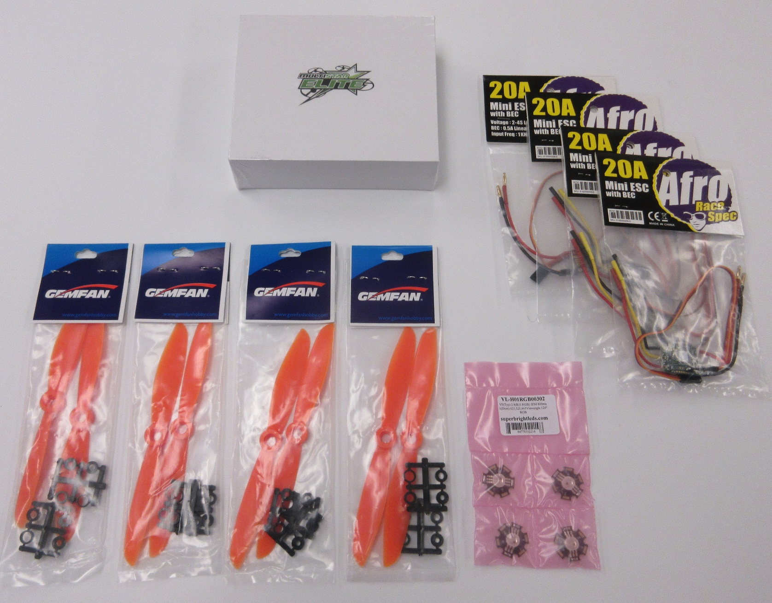
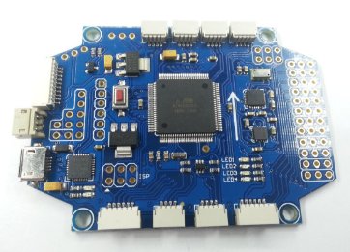
System Analysis and Part Choices
MultiWii Pro vs. DJI Naza
Motors – Multistar Elite Racing 2204
ESC’s – Afro Race Spec
LED’s – Vollong 3W RGB
http://www.readytoflyquads.com/multiwii-pro-ez3-0-flight-controller-w-gps-option

Slide 10
Testing Plan

Slide 11
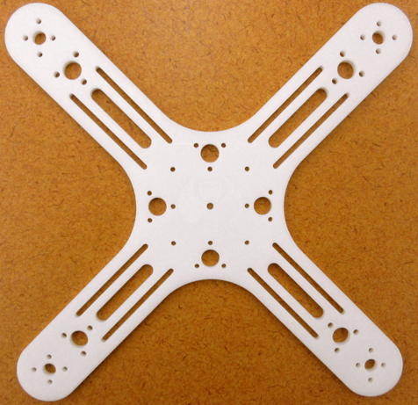
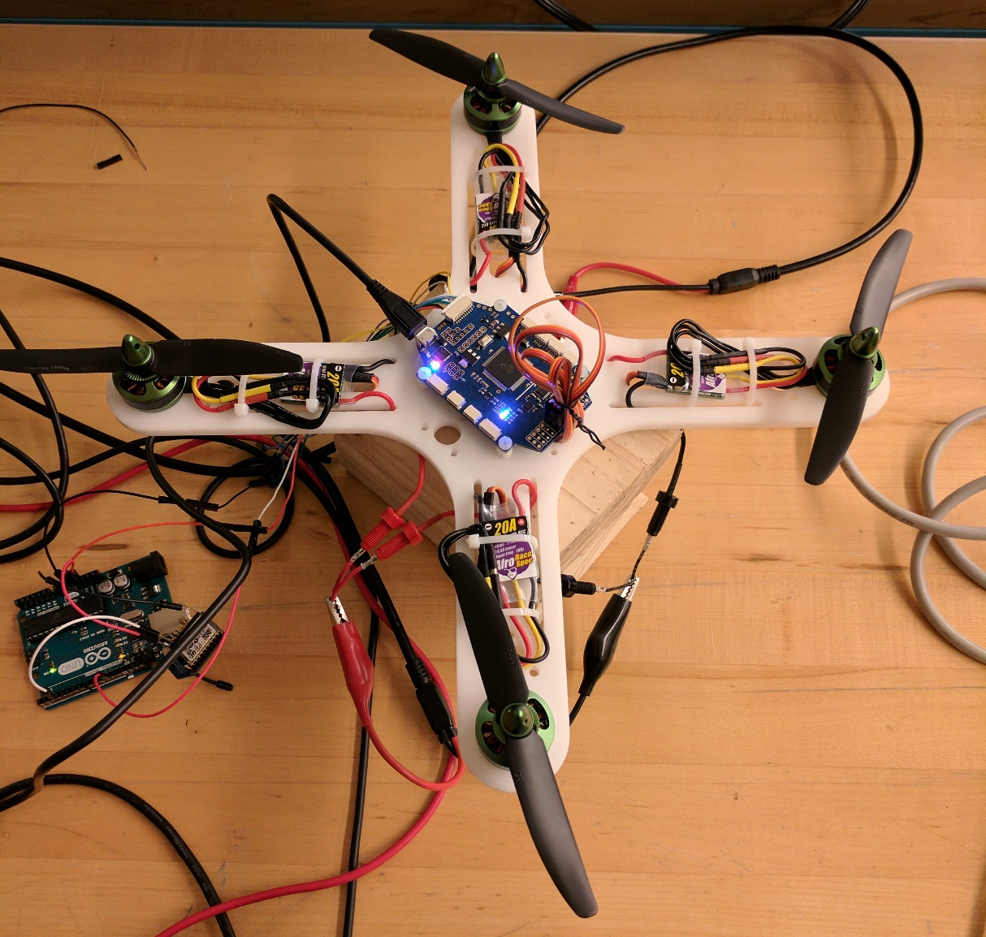
Prototyping

Slide 12
Communications Demo

Slide 13
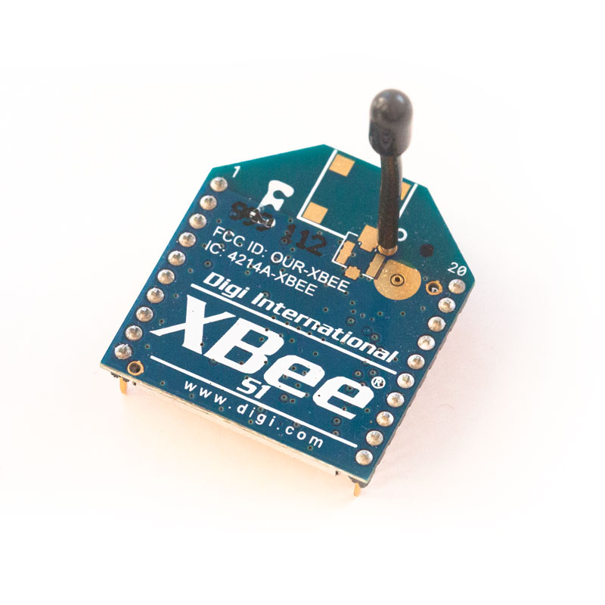
Wireless Communication
XBee series 1 Radio
ISM 2.4 GHz Operating Frequency
Data Rate = 250 kbps
Indoor Range 100ft
Outdoor Range 300ft

Slide 14
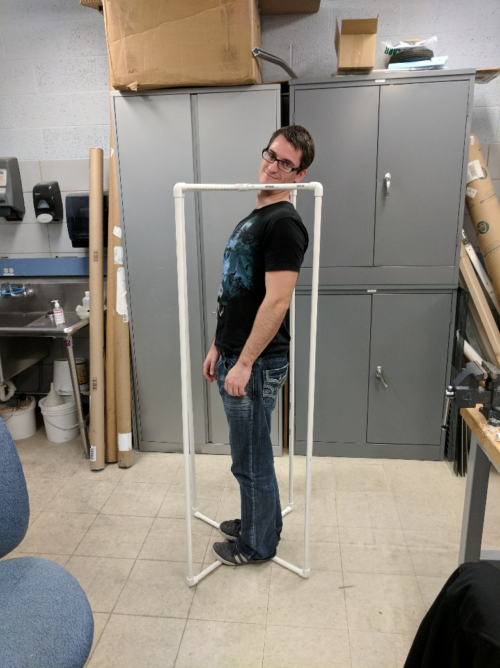
Test Fixture

Slide 15
Propeller Choices
5x3
12.6V (3S): 50%=224g 3.7A, 100%= 371g 7.5A (Hover amps @ 125g thrust=1.7A (x 4=500g=6.8A) 8.4V (2S): 50%=120g 2.2A, 100%= 200g 4.3A (Hover amps @ 125g thrust=2.2A (x 4=500g=8.8A)
5x3x3 (3 blade)
12.6V (3S): 50%=232g 4.7A, 100%= 392g 9.9A (Hover amps @ 125g thrust=2.0A (x 4=500g=8A) 8.4V (2S): 50%=134g 2.7A 100%= 221g 6.7A (Hover amps @ 125g thrust=2.7A (x 4=500g=10.8A)
6x4
12.6V (3S): 50%=385g 7.5A, 100%= 591g 9.9A (Hover amps @ 125g thrust=1.4A (x 4=500g=5.6A) 8.4V (2S): 50%=230g 4.8A, 100%= 367g 9.7A (Hover amps @ 125g thrust=2.1A (x 4=500g=8.4A)
Current Quad Weight = 323g

Slide 16
Estimated Power Consumption
Quadcopter weighs 323g => est. 360g Fully Loaded
Flight Controller, MCU, etc. << 1W
LEDs 3W each. 4 LEDs = 12 W
Motor with 5x3 Prop
Hovering Current = 1.7A @ 12.6V each
Total Power = 85W providing 500g Lift
Burst Current = 3.7A @ 12.6V each motor
Total Power = 186W providing 896g Lift
Overestimated 97W at Hover

Slide 17
EE492

Slide 18
Goals
LED Circuit Design, Prototype, & Test
Hovering & Flight Control Improvements
Flight Test Fixture
Tether System
PCB’s Design and Printed.
Final Assembly

Slide 19
Tether Control Box Sketch

Slide 20
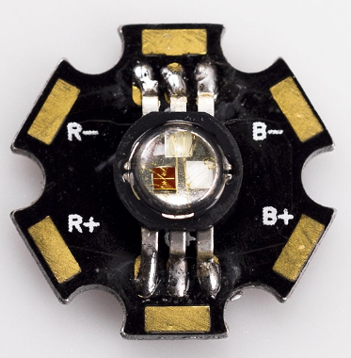
Basic LED PWM Control Schematic
PWM Control From Microcontroller
Vollong 3w RGB Common Cathode LEDS
P-Channel Power MOSFET Choices
Fairchild FQP27P06
Fairchild NDP6020P

Slide 21
PCB Design
Atmega328 Microcontroller
XBee Wireless Transceiver
Two voltage regulators: 5v and 3v3
LED driving MOSFETs

Slide 22
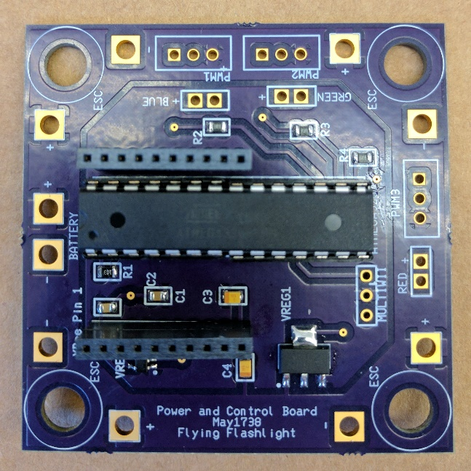
PCB Design II
Outer Power Plane: 12v
Inner Power Plane: 5v
Headers for Red, Green, Blue LEDs

Slide 23
Winch Tether System

Slide 24
Winch Tether System II
Design work done in SolidWorks
Lee Harker assisted with design
Slip rings used to transfer power
Parts milled using CNC mill, performed by Lee Harker
Aluminum used for end supports
PVC, Acrylic used for hubs/drum
Gear supplied by ServoCity
Slip rings supplied by DigiKey
Bearings supplied by McMaster-Carr

Slide 25
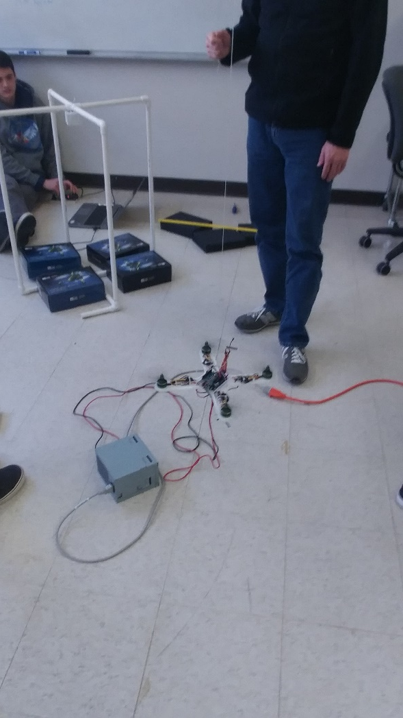
Flight Testing
Accelerometer Calibration
PID Tuning

